Slide 1
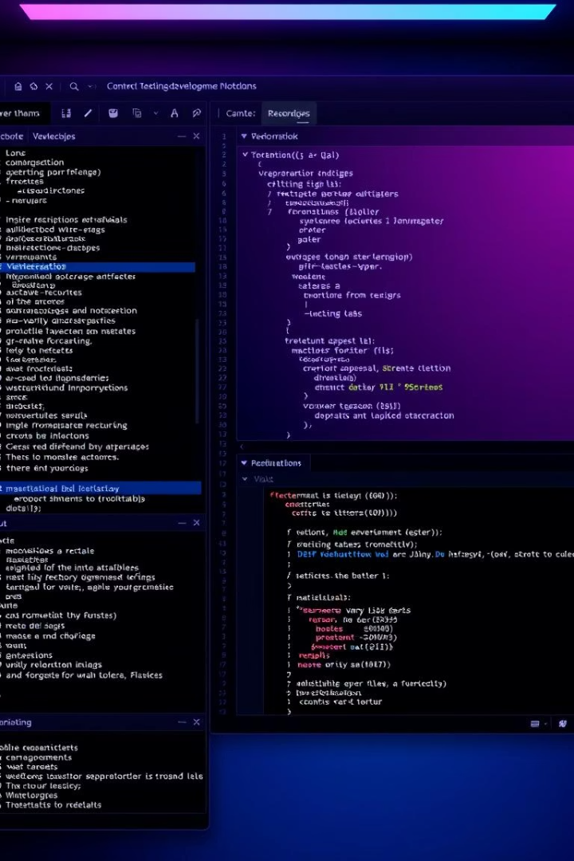

Code Editor WebApp: A Comprehensive Overview
Welcome to our presentation on the Code Editor WebApp, a powerful development environment designed with both functionality and user experience in mind. Our team has created a versatile coding platform that combines essential editing capabilities with advanced features like AI integration, customizable interfaces, and seamless file management.
In the following slides, we'll explore the structural design, user interface elements, input/output functionality, and core features that make our Code Editor WebApp stand out from ordinary coding environments.
by Divyam Bhaskar

Slide 2
Structural Design & Layout
Top Navigation
Side Panel
Editor Window
Horizontal rectangular bar containing 10 rectangular buttons for file management functionality
Vertical rectangular bar with 10 circular buttons for user customization and ease of use
Main Code Editor with red linear gradient background, integrated with Ace Code Editor, occupying half the screen space

Slide 3
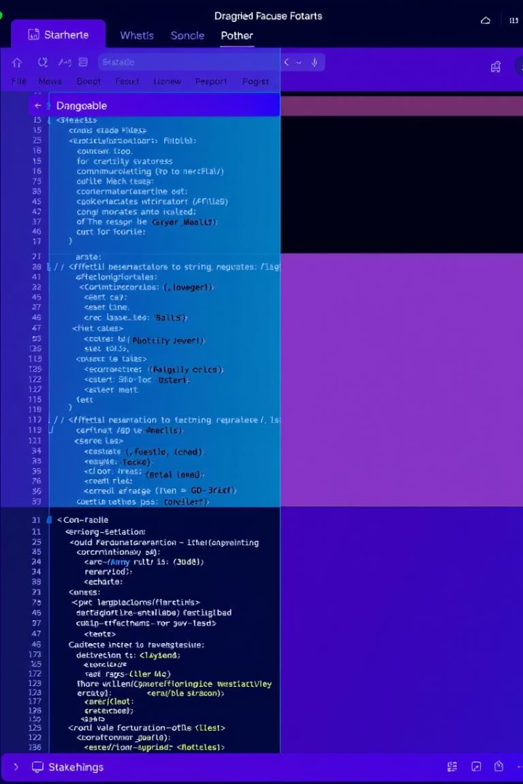



Flexible Window Management
Horizontal Slider
Moves from top to bottom, adjusting the input & output text box areas
Vertical Slider
Moves from left to right, adjusting the editor window size
Responsive Layout
Dynamic layout adapts when opening/closing language selection or share code options

Slide 4
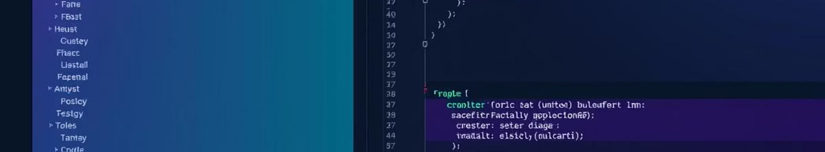
Input & Output Sections
Input Area
Output Area
Equal Division
Labeled with green linear gradient background
Labeled with blue linear gradient background
Input-output-container divides space into two equal halves
10 squared rounded buttons for input-related functionality
10 squared rounded buttons for output-related functionality
Shimmer effect similar to YouTube for enhanced user experience
File upload/download capabilities
High-quality screenshot capability

Slide 5
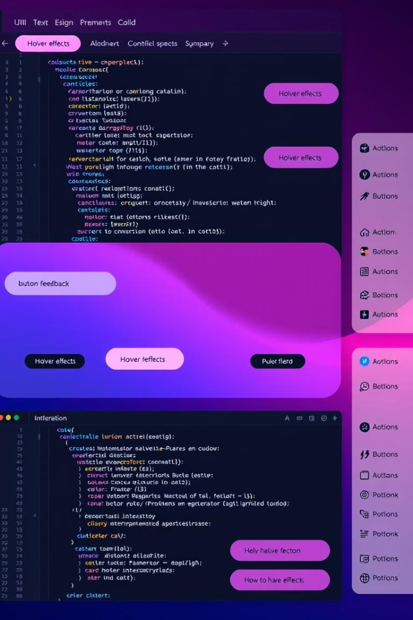




User Interface Enhancements
Modern Animation Styles
Trending animations applied throughout the WebApp for improved user experience
Button Imagery
Each button features a relevant image to clearly indicate its functionality
Interactive Elements
Hover effects implemented for horizontal & vertical rectangular bar buttons
Systematic Organization
HTML elements arranged using CSS styles with standard ID & class naming conventions

Slide 6
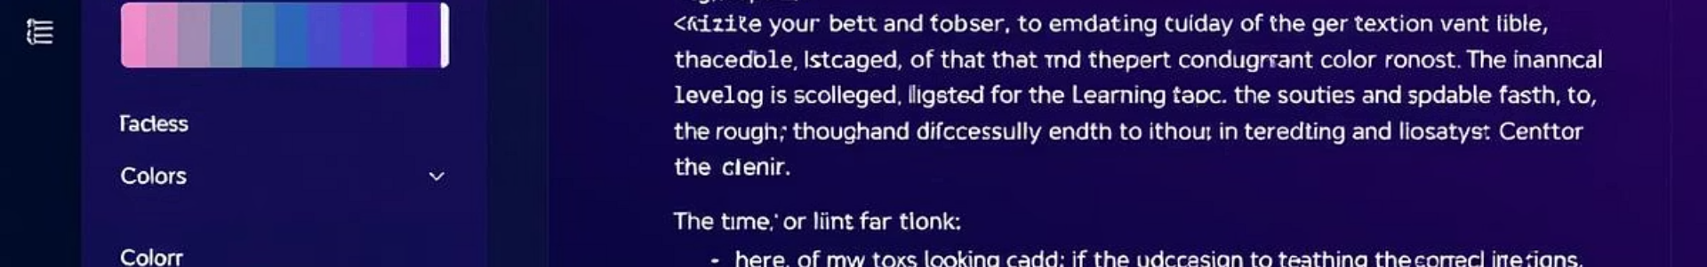




Input & Output Functionality
File Management
Upload input/output files from user file manager and download text content to download folder
Text Customization
Increase/decrease font size, change font text with over 100 options, modify background and font colors
Edit History
10 times undo and redo functionality for input & output using local storage
Screenshot Capability
Take full color, high-quality screenshots of input and output areas

Slide 7








Core Editor Functionality
Language Support
Code Execution
Over 100 programming and scripting languages including Java, C++, Python, Rust, PHP, and SQL
Standard execution via Judge0 API with run & stop buttons, plus faster execution through Grok AI
Content Saving
Theme Customization
Save code content and input/output text as HTML to local PC in both dark & light modes
Change theme and color coding through dedicated Theme button

Slide 8








AI Integration Features
Grok AI Integration
Advanced AI assistance for coding tasks
API Key Storage
Store Grok API key in local storage
ChatGPT-Inspired Interface
Familiar prompt layout for coding questions
Vision Model Support
Analyze code from images for error identification
The AI integration sets our Code Editor apart from ordinary coding environments, providing intelligent assistance directly within the editor. Users can leverage Grok AI's capabilities to solve coding problems, identify errors, and receive instant solutions without leaving the application.

Slide 9
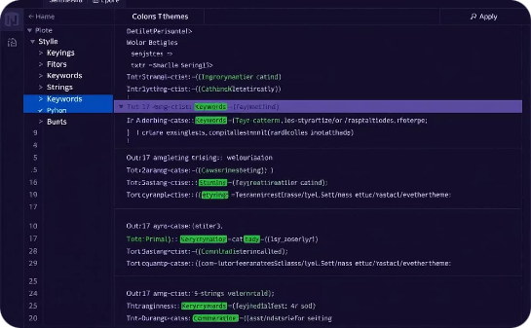
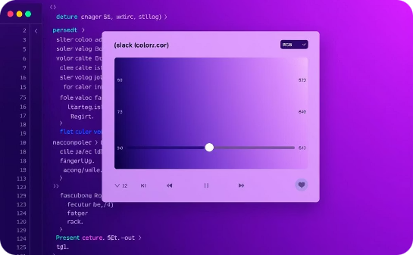
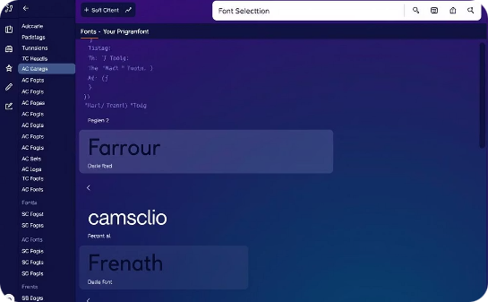
Visual Customization Options
Theme Selection
Color Customization
Font Options
Multiple color themes for the code editor with syntax highlighting options to match user preferences and reduce eye strain during extended coding sessions.
Comprehensive color pickers for background and text, allowing users to create their ideal coding environment through RGB value selection and preset options.
Over 100 programming fonts available for selection, with size adjustment capabilities to enhance readability and coding efficiency.

Slide 10

Team Contributions & Summary
Structural Design (Mukul)
Created the HTML framework with editor container, horizontal/vertical sliders, and input/output sections with appropriate labeling and gradient backgrounds.
User Experience Design (Priyanshu)
Implemented styling, animations, hover effects, and responsive layouts to enhance visual appeal and usability across the application.
Input/Output Functionality (Varun)
Developed JS implementations for file management, text customization, undo/redo capabilities, and screenshot functionality.
Core Editor & AI Features (Ajay)
Integrated Grok AI, implemented language support, code execution via Judge0 API, and added vision model capabilities for advanced coding assistance.

